Slide 1


OAGB versus RYGB COME PROCEDURA REVISIONALE
Dr A. Susa
ICSR di Franciacorta Ome (BS)

Slide 2
OAGB versus RYGB
COME PROCEDURA REVISIONALE
Procedure revisionali
-Revisione:
-Conversione:
procedure che modificano parti di un intervento senza alterarne la tipologia
procedura che porta a cambiamento di tipologia e/o meccanismo di azione
-Restaurazione: procedure che restaurano la
normale anatomia

Slide 3
Indicazioni per intervento revisionale
OAGB versus RYGB
COME PROCEDURA REVISIONALE
-Insufficiente calo ponderale
-Ripresa ponderale
-GERD
-Reflusso biliare
-Eccessivo calo ponderale
-Malnutrizione /malassorbimento
-Ripresa di comorbidità
-Complicanze ad es : Erosione
Slippage Ernia interna

Slide 4
OAGB versus RYGB
COME PROCEDURA REVISIONALE
●
2024 26702 procedure | chirurgiche in Italia
-Sleeve Gastrectomy | 55%
-RNY bypass | 15%
-OAGB | 12%
-Bendaggio Gastrico | 4%

Slide 5
Reoperations After Bariatric Surgery in 26 Years of Follow-up of the Swedish Obese Subjects Study
jAMA Surg. 2019 Jan 2;154(4):319–326
OAGB versus RYGB
COME PROCEDURA REVISIONALE
interventi di revisione generalmente entro 10 anni
Interventi di conversione/restaurazione in tutto il periodi di follow-up
Reinterventi dopo bendaggi gastrico 40,7% Rny Bypass 7,5%
Gastroplastica verticale 28,3%
Weight loss,weight regain and conversion to RNY gastric by pass: 10 years results of laparoscopic sleeve gastrectomy.
Soard 2016 12(9) 1655-62 Felsenreich Dm e al.
Reinterventi dopo sleeve gastrectomy 20.7 %
●
●
●
●

Slide 6
Casistica SICOB 2010/2024
OAGB versus RYGB
COME PROCEDURA REVISIONALE
●
- Sleeve Gastrectomy | 118.443
- RNY bypass | 34.563
- OAGB | 24.098
- Bendaggio gastrico | 27.330

Slide 7
Revisional bariatric surgery following sleeve gastrectomy: a meta-analysis comparing Roux-en-Y gastric bypass and one anastomosis gastric bypass
Ann R Coll Surg Engl
. 2024 Jul 31;107(3):180–187. G.Santoro et Al.
Year Country Journal Design Follow-up
Author
Chiappetta et al 2018 Germany/Italy Obesity Surgery Retrospective 12
Rayman et al 2021 Israel Obesity Surgery Retrospective 32 Rheinwalt et al 2022 Germany World Journal of Surgery Retrospective 24 Felsenreich et al 2022 Austria Obesity Surgery Retrospective 60 Auricchio et al 2022 Italy Surgeries Retrospective 12 Wilczyński et al. 2022 Poland J. of Gastrointestinal Surger Retrospective 60
Hany et al 2022 Egypt Obesity Surgery R.C.T. 24
12
10
A total of 802 patients met the inclusion criteria: 390 OAGB and 412 RYGB
8

Slide 8
Revisional bariatric surgery following sleeve gastrectomy: a meta-analysis comparing Roux-en-Y gastric bypass and one anastomosis gastric bypass
Ann R Coll Surg Engl
. 2024 Jul 31;107(3):180–187. G.Santoro et Al.
●
Author
Pre-revisional BMI (kg/m2)
Post-revisional BMI (kg/m2)
●
 | OAGB | RYGB | OAGB | RYGB
Chiappetta et al | 45.7 ± 8 | 36.6 ± 6.9 | 36.6 ± 6.3 | 33.5 ± 5.6
Rayman et al | 41.6 ± 5. | 39.6 ± 5.0 | 31.8 ± 5.3 | 33.3 ± 5.0
Rheinwalt et al | 45.5 | 39.3 | 31 | 35
Felsenreich et al | 45.0 ± 7.3 | 38.6 ± 8.6 | 30.3 ± 8.5 | 31.4 ± 8.1
Hany et al | 45.1 ± 8.3 | 44.9 ± 6.6 | 27.8 ± 2.2 | 27.4 ± 3.1
●
●
●
●
●
Pre- and post-revisional surgery BMI
with no statistically significant difference between the two groups (p = 0.1882) .

Slide 9
Revisional bariatric surgery following sleeve gastrectomy: a meta-analysis comparing Roux-en-Y gastric bypass and one anastomosis gastric bypass
Ann R Coll Surg Engl
. 2024 Jul 31;107(3):180–187. G.Santoro et Al.
●
Author
Pre-revisional BMI (kg/m2)
Post-revisional BMI (kg/m2)
●
 | OAGB | RYGB | OAGB | RYGB
Chiappetta et al | 45.7 ± 8 | 36.6 ± 6.9 | 36.6 ± 6.3 | 33.5 ± 5.6
Rayman et al | 41.6 ± 5. | 39.6 ± 5.0 | 31.8 ± 5.3 | 33.3 ± 5.0
Rheinwalt et al | 45.5 | 39.3 | 31 | 35
Felsenreich et al | 45.0 ± 7.3 | 38.6 ± 8.6 | 30.3 ± 8.5 | 31.4 ± 8.1
Hany et al | 45.1 ± 8.3 | 44.9 ± 6.6 | 27.8 ± 2.2 | 27.4 ± 3.1
●
●
●
●
●
Pre- and post-revisional surgery BMI
with no statistically significant difference between the two groups (p = 0.1882) .

Slide 10
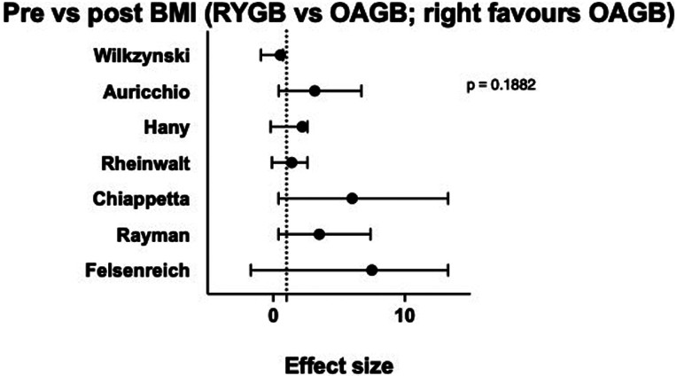
Revisional bariatric surgery following sleeve gastrectomy: a meta-analysis comparing Roux-en-Y gastric bypass and one anastomosis gastric bypass
Ann R Coll Surg Engl
. 2024 Jul 31;107(3):180–187. G.Santoro et Al

Slide 11
Revisional bariatric surgery following sleeve gastrectomy: a meta-analysis comparing Roux-en-Y gastric bypass and one anastomosis gastric by
Ann R Coll Surg Engl
. 2024 Jul 31;107(3):180–187. G.Santoro et Al

Slide 12
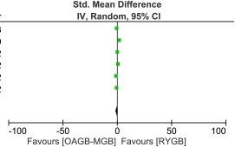
Revisional bariatric surgery following sleeve gastrectomy: a meta-analysis comparing Roux-en-Y gastric bypass and one anastomosis gastric bypass
Ann R Coll Surg Engl
. 2024 Jul 31;107(3):180–187. G.Santoro et Al
Excess weight loss was reported in six papers for a total of 642 patients.
There were 310 patients in the OAGB group and 332 patients in the RYGB group).
At 12-month follow-up, there was no statistically significant difference between OAGB and RYGB.
●

Slide 13
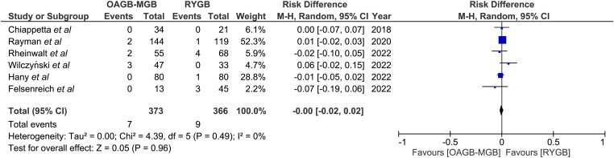
Revisional bariatric surgery following sleeve gastrectomy: a meta-analysis comparing Roux-en-Y gastric bypass and one anastomosis gastric bypass
Ann R Coll Surg Engl
. 2024 Jul 31;107(3):180–187. G.Santoro et A
●
Anastomotic leak was reported in six studies for a total of 739 patients The OAGB group reported 7 of 373 (1.8%) leaks, whereas
the RYGB group had 9 of 366 (2.4%) leaks.
There was no statistically significant difference

Slide 14
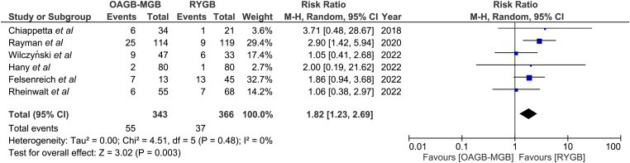
Revisional bariatric surgery following sleeve gastrectomy: a meta-analysis comparing Roux-en-Y gastric bypass and one anastomosis gastric bypass
Ann R Coll Surg Engl
. 2024 Jul 31;107(3):180–187. G.Santoro et Al
●
Postoperative reflux was reported in six papers (Figure 6).10–13,15,16
The incidence of de novo postoperative reflux was higher in the OAGB group than in the RYGB group [55 of 343 (16%) vs 37 of 366 (10.1%)].
This difference was statistically significant (p < 0.003) in favour of RYGB
.
.

Slide 15
Revisional bariatric surgery following sleeve gastrectomy: a meta-analysis comparing Roux-en-Y gastric bypass and one anastomosis gastric bypass
Ann R Coll Surg Engl
. 2024 Jul 31;107(3):180–187. G.Santoro et A
●
Postoperative bleeding was reported in six studies, for a total
of 739 patients Postoperative bleeding requiring intervention was similar in the RYGB and OAGB
This difference was not statistically significant.
●
Operative time was reported in three studies, for a total of 338 patients The remaining three studies did not adequately report operative times.
Operative time was significantly
lower in OAGB compared with RYGB.

Slide 16
Revisional bariatric surgery following sleeve gastrectomy: a meta-analysis comparing Roux-en-Y gastric bypass and one anastomosis gastric bypass
Ann R Coll Surg Engl
. 2024 Jul 31;107(3):180–187. G.Santoro et A
●
COMORBIDITY RESOLUTION (Three years)
Resolution of comorbidities was reported in six papers.
The three comorbidities documented were diabetes, hypertension and obstructive sleep apnoea.
The OAGB group had a greater resolution of
-diabetes (79.5% vs 61.2%, p = 0.1708),
-obstructive sleep apnoea (75.0% vs 64.3%, p = 0.2563)
- hypertension (67.3% vs 48.5%, p = 0.3199) compared
with the RYGB group
●
None of the differences were statistically significant.

Slide 17
OAGB versus RYGB
COME PROCEDURA REVISIONALE
One anastomosis gastric bypass vs. Roux-en-Y gastric bypass, remedy for insufficient weight loss and weight regain after failed restrictive bariatric surgery
Nathan Poublon et al Obes Surg. 2020 Apr 19;30(9):3287–3294
●491 patients operated on between 2012 and 2017 for failed restrictive surgery were included in this study (OAGB (n=185) or RYGB (n=306)
.
Gastric sleeve 140 Adjustable gastric banding 251
Procedure time was significantly shorter in the OAGB group
(median time 72 [56–95] minutes vs. 83 [66–103] minutes, p < 0.001
.

Slide 18
One anastomosis gastric bypass vs. Roux-en-Y gastric bypass, remedy for insufficient weight loss and weight regain after failed restrictive bariatric surgery
Nathan Poublon et al Obes Surg. 2020 Apr 19;30(9):3287–3294
●
Fate clic per aggiungere testo
BMI was significantly lower in the OAGB group at
24 months (mean 30.8 ± 5.2 vs. 32.6 ± 5.9, p = 0.016)
36 months (mean 31.1 ± 5.1 vs. 34.3 ± 7.1, p = 0.012).
%TWL was significantly larger in the OAGB group at 12 months (mean 24.1 ± 9.8 vs. 21.9 ± 9.7, p = 0.023)
24 months (mean 23.9 ± 11.7 vs. 20.5 ± 11.2, p = 0.023) follow-up.

Slide 19
One anastomosis gastric bypass vs. Roux-en-Y gastric bypass, remedy for insufficient weight loss and weight regain
after failed restrictive bariatric surgery
Nathan Poublon et al Obes Surg. 2020 Apr 19;30(9):3287–3294
Complications
Significantly less early intra-abdominal complications (leakage, bleeding, intra-abdominal abscess, and perforation) were present after revisional OAGB compared with RYGB
(1.1% vs. 4.9%, p = 0.025)
No significant difference in the cumulative rate of surgical intervention for any cause due to long-term (> 30 days) complications
was found between groups (OAGB vs. RYGB: 9.2% vs. 12.4%, p = 0.227).

Slide 20
OAGB versus RYGB
COME PROCEDURA REVISIONALE
SINTESI
●
TWL% e variazione del BMI tendenzialmente superiori per OAGB , più evidente nel lungo periodo.
●
●
Miglior trend di risoluzione delle comorbidità a tre anni con OAGB
●
●
Tempo operatorio più breve con OAGB
●
●
Minor incidenza di reflusso postoperatorio con RGBY
●
●
Non differenza di complicanze post operatorie precoci / tardive

Slide 21
Grazie

